Slide 1
Career Advice Recommendation System
Andrew, Jim, Grace and Lucy
W210 Capstone

Slide 2
Intro + Problem
Platform for job seekers to help them take the next steps in their careers.
Provide an “FAQ” based on a user’s work history
Serve users with questions asked by similar jobseekers and corresponding answers
Allow users to explore advice that others like them have sought and received
Previous capstones have explored similar projects
Example: “iCareer Climber: Eliminate Guesswork from Your Career Planning” - Summer 2018 Capstone Project
We hope to leverage their work to provide additional features like skill-matching and related job titles
Notes:
Website: https://icareerclimber.github.io/
Scrapped data from 100,000s of resumes, which is used as the basis for a recommendation system for career paths and skill development

Slide 3
Data + Solutions
Data:
Kaggle dataset of questions and answers from career advisors and students: https://www.kaggle.com/c/data-science-for-good-careervillage/data
Quora Webscraping: https://www.quora.com/
Career Climber Data Pipeline: https://icareerclimber.github.io/howitworks/data-pipeline/
Additional data from public sources such as Bureau of Labor Statistics as needed
Solutions:
Classification of users into industry/career-level clusters
Combined with rankings of best Q+A for each cluster

Slide 4
Presentation 1: EDA

Slide 5
Project Introduction
Problem: Limited resources for job seekers to find advice related to potential career paths; existing resources scattered across many sites.
Our solution: Consolidate these sources and provide recommendations of relevant advice for job seekers based on work history / desired job titles
Project Scope:
Minimal: Collection of recommended question/answer pairs of advice related to user’s profession
Maximal: Full dashboard of summarized advice, combined with suggested career paths and statistics on job availability and earnings
Previous Work: Sites like LinkedIn and Quora have forums with discussion on careers (presumably backed by some recommender systems for serving content to users). To our knowledge, no one has attempted to aggregate these sources.

Slide 6
Data Overview - CareerVillage
Tags questions (153106, 2)
Tags (32538, 2)
Question scores (47856, 2)
Questions (119655, 5)
Comments (74830, 5)
Answer scores (102276, 2)
Answers (255615, 5)
Professionals (140760, 5)
Notes:
Jim

Slide 7
Example Questions + Answers
Metadata
Will going abroad for your first job increase your chances for jobs back home?
I'm planning on going abroad for my first job. It will be a teaching job and I don't have any serious career ideas. I don't know what job I would be working if I stay home instead so I'm assuming staying or leaving won't makeba huge difference in what I care about, unless I find something before my first job. I can think of ways that going abroad can be seen as good and bad. I do not know which side respectable employers willl side with. #working-abroad #employment- #overseas
<p>I work for a global company who values highly international experience. In fact, that is a key experience we look for in candidates. Therefore, I'd say it would be wise to take advantage of the teaching opportunity - even if only for a year or 2. You never know where it might lead and you will certainly have an edge on your return if you then look for employment in a global company.</p>
As a civil engineer, what percent of your time would you say per week you spend on site helping to organize construction efforts and people and what percent of your time do you spend in an office making calculation and coming up with designs?
I would love to be a civil engineer one day. I definitely don't want to be a construction worker and spend all day outside working with tools and building things but I also wouldn't want a 10 hour a day desk job. Civil engineer seems like a happy medium and I just wondered from a professional if that was the case. #mathematics #civil-engineering
<p>It all depends on what type of job you have. In my days as a new Civil Engineer, I also spent my full days either drafting or making calculations. During my structural design days, I spent all hours of the day in the office making calculations. Never saw a project. When I hit Public Work things changed. I did visit project sites, did project administration, did calculations and other administrative work. The amount of time spent on the various items was completely dependent on the project and what was happening. You can go days without getting out of the office and then you can spent an inordinate amount of time in the field. It is extremely variable. I loved it!</p>
Student ID
Location
Question ID
Score
Tags
Professional ID
Location
Industry
Profession
Answer ID
Score
Comments
Notes:
Jim

Slide 8
Industries + Topics
What industries are most represented?
What industries have the best answer quality?
What locations (both students and professionals)?
What schools?
Notes:
Grace

Slide 9
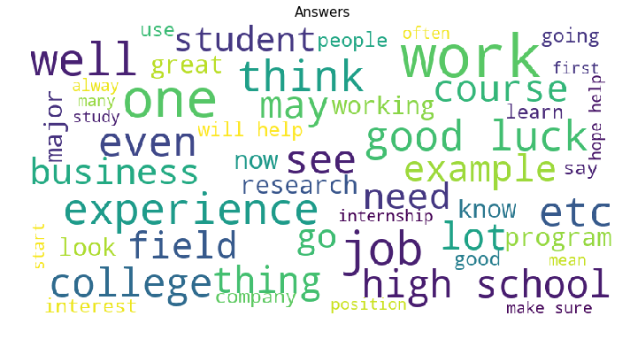
Preprocessing for Summarization
Extract Text from HTML
Convert to lower-case and parse out URLs
Remove special characters
Using BeautifulSoup package
Input: '<p>Hi!</p>\n<p>You are asking a very interesting question. I am giving you two sites that will give you some of an explanation that may answer your question. </p>\n<p>http://mathforum.org/dr.math/faq/faq.why.math.html</p><p>Let me know if this helps</p>'
Output: 'Hi! You are asking a very interesting question. I am giving you two sites that will give you some of an explanation that may answer your question. http://mathforum.org/dr.math/faq/faq.why.math.html Let me know if this helps'
URLs don’t work well in summarization, but we will store them separately in a “Recommended links” section
Output:
'hi! you are asking a very interesting question. i am giving you two sites that will give you some of an explanation that may answer your question. let me know if this helps'
Output:
'hi you are asking a very interesting question i am giving you two sites that will give you some of an explanation that may answer your question let me know if this helps'
Notes:
Lucy

Slide 10
Next Steps
Summarization of questions and answers
Recommendation for similar questions
Clustering to assign tags to ALL questions
Expanding the dataset - using quora?
Notes:
Grace

